Slide 1
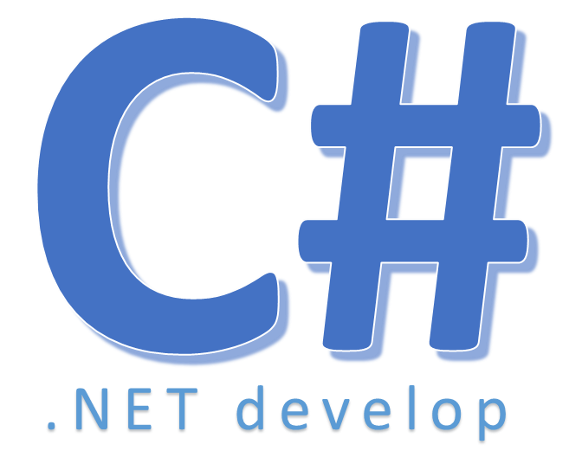

Lambda Expressions

Slide 2
Nội dung
Lambda Expressions is an Anonymous function
– A function without a name
– Perform action , return a single value
– Can be used wherever a delegate type is valid
Why?
– Allow a function’s caller to define the action
– Not just pass parameters
– Lambda expressions provide a clearer syntax for anonymous delegates

Slide 3
Nội dung
Syntax
– parameters => expression
– a functional superset of anonymous methods
– Lambda expressions can "infer" parameter types, even if you omit them
– Lambda expressions can use both statement blocks and expressions
Notes:
- Giông khai báo hàm dạng expression trong javascript

Slide 4
Nội dung
Use lambda operator =>
– Read as “goes to”
– x=>x+3 if x=1 then 4 is returned
– x=> x==5: if x=5, True is returned
– (x,y)=> x+y if x=2, y=4 then 6 is returned
– (x,y)=>x==y if x=2, y=4 then False is returned

Slide 5
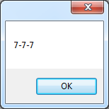
Nội dung
private void button8_Click
(object sender, EventArgs e)
{
ChangeInt d=((int x)=>x+2);//lambda expression
ChangeInt d1 = (k => k + 2);//lambda expression
ChangeInt d2 = delegate(int x)//anonymous method
{
return x + 2;
};
MessageBox.Show(d(5)+"-"+d1(5)+"-"+d2(5));
}
Notes:
- gọi hàm

Slide 6
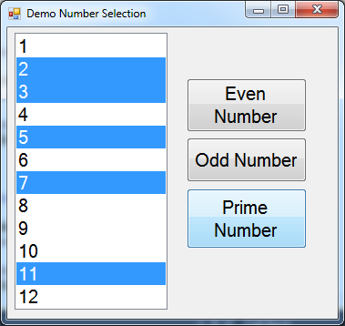
Nội dung
delegate: turn back to example: lambda
private void btnEven_Click(object sender, EventArgs e)
{
listNumber.SelectItemInListBox(x => x % 2 == 0);
}

Slide 7


Hey! Coding is easy!
END

